Slide 1

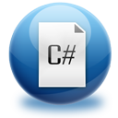


C# Part 1 - Summary
What you need to know
Ivaylo Kenov
Telerik Academy Student
Telerik Corporation
http:/telerikacademy.com

Slide 2

Table of Contents
Primitive data types and variables
Operators and expressions
Console In and Out
Conditions
Loops
Algorithms
Bonus: Arrays

Slide 3

Primitive data types
How to store data

Slide 4
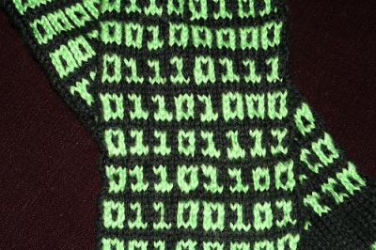

Primitive data types (1)
Numbers
int, long - -4, -1213432, 0, 5, 145, 1224234
double, decimal – 4.5, -1234.578, 145.0001
Notes:
Use long when you expect huge results, otherwise int
Use decimal if you want high precision, otherwise double

Slide 5

Primitive data types (2)
Example
Bonus: BigInteger
Add reference to System.Numerics
Use only if results are really huge!
Slow operations
int number = 1;
long hugeNumber = 999999999999;
double otherNumber = 1.2;
decimal num = 1.567m;

Slide 6

Primitive data types (3)
bool – true or false
char – 'a', 'b', 'c'
Is actually int – you can make operations on it
bool isGreater = (a > b);
bool isSame = (a == b);
bool isDifferent = (a != b);
char a = 'a';
char someChar = 'a' + 'b';

Slide 7
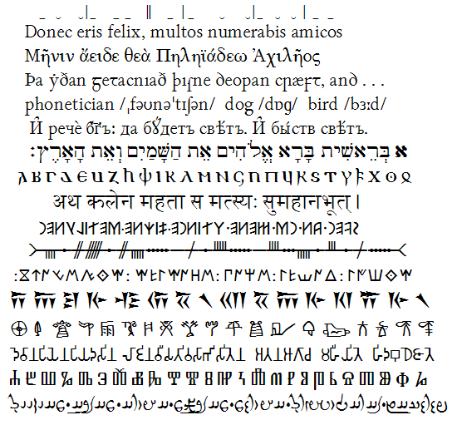
Primitive data types (4)
string – basically text, sequence of chars
You can concatenate strings with +
You can use placeholders
string firstName = "Ivan";
string lastName = @"Ivanov";
string fullName = firstName + " " + lastName;
"Your full name is {0} {1} {2}.", firstName, fatherName, lastName

Slide 8
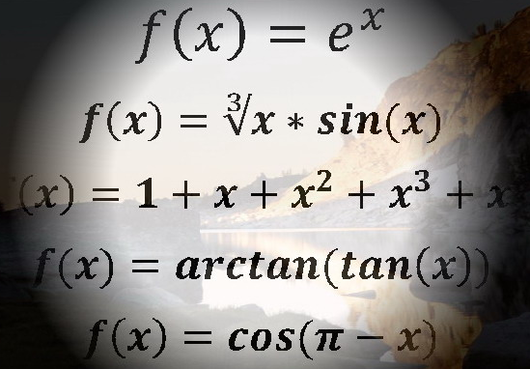
Variables
How to use data

Slide 9
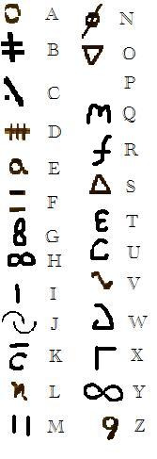
Variables (1)
Declaring
Assigning
Text escaping
\' for single quote \" for double quote
\\ for backslash \n for new line
<data_type> <identifier> [= <initialization>];
int firstValue = 5;
int secondValue = firstValue;
int num = new int();

Slide 10


Variables (2)
Other:
Null – no value (used with ?)
Every type has .ToString()
"string".Length
Some literals need 'f', 'm', 'd', etc. at the end
Object can be used for everything
new string('.', 5) is equal to "….."
Use only letters, numbers and '_' for naming

Slide 11

Operators and expressions
Math starts here

Slide 12
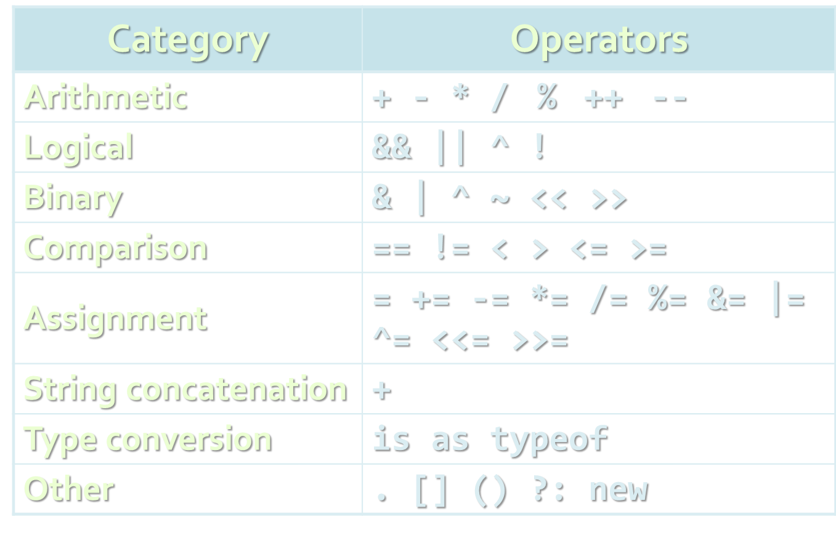
Operators and expressions (1)
Note: Always use parentheses just to be sure!

Slide 13
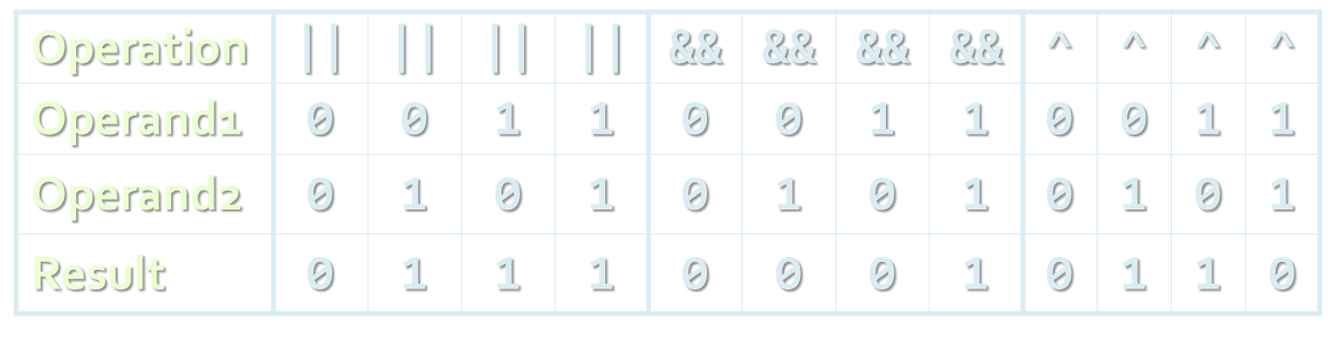
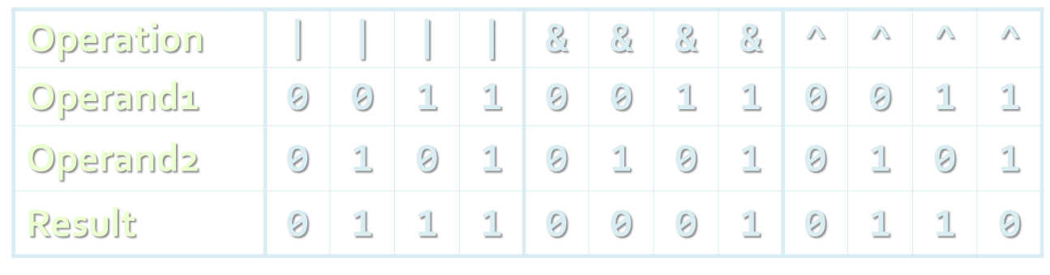
Operators and expressions (2)
Logical operators – used on booleans
! turns true to false and false to true
Bitwise operators - <<, >> and ~

Slide 14

Operators and expressions (3)
Other
Square brackets [] are used with arrays indexers and attributes
Class cast operator (type) is used to cast one compatible type to another
The new operator is used to create new objects
Bonus: Math class
Has Sin, Cos, Log, Ln, Pow, Min, Max functions for easy calculations

Slide 15

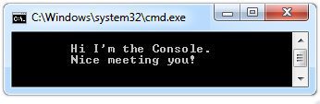

Console In and Out
Reading and writing

Slide 16
Console In and Out (1)
Input
Read(…) – reads a single character
ReadKey(…) – reads a combination of keys
ReadLine(…) – reads a single line of characters
Output
Write(…) – prints the specified argument on the console
WriteLine(…) – prints specified data to the console and moves to the next line

Slide 17
Console In and Out (2)
Format
{index[,alignment][:formatString]}
Converting
int.Parse(), long.Parse, double.Parse(), etc.
Convert.ToInt32(string)
Invariant culture
using System.Threading;
using System.Globalization;
…
Thread.CurrentThread.CurrentCulture =
CultureInfo.InvariantCulture;

Slide 18

Conditional statements
Implementing logic

Slide 19
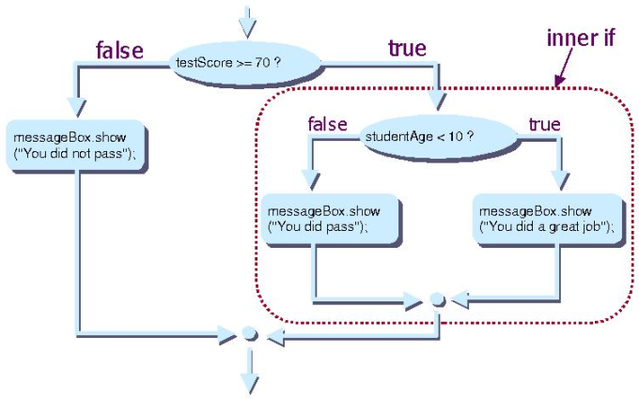
Conditional statements (1)
If-else statement
Note: else is not required
Conditions can be nested
else can be else if
if (expression)
{
statement1;
}
else
{
statement2;
}

Slide 20
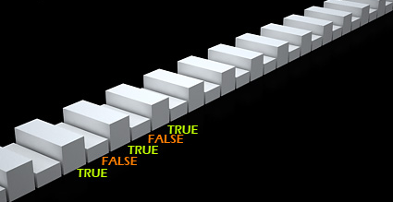
Conditional statements (2)
Switch statement
switch (day)
{
case 1: Console.WriteLine("Monday"); break;
case 2: Console.WriteLine("Tuesday"); break;
case 3: Console.WriteLine("Wednesday"); break;
case 4: Console.WriteLine("Thursday"); break;
case 5: Console.WriteLine("Friday"); break;
case 6: Console.WriteLine("Saturday"); break;
case 7: Console.WriteLine("Sunday"); break;
default: Console.WriteLine("Error!"); break;
}

Slide 21

Loops
Repeating the code

Slide 22

Loops (1)
while loop
do-while loop
while (condition)
{
statements;
}
do
{
statements;
}
while (condition);

Slide 23

Loops (2)
for loop
foreach loop
for (initialization; test; update) { statements; }
foreach (Type element in collection) { statements; }

Slide 24

Loops (3)
Jump statements
break
continue
goto (avoid using it!)
for (int inner = 0; inner < 10; inner++)
{ if (inner % 3 == 0)
continue; if (inner == 7)
break; if (inner + 5 > 9)
goto breakOut; } breakOut:

Slide 25

Algorithms
Useful code

Slide 26

Algorithms (1)
DateTime
Has various methods for dates and time
Date can be saved in numerous formats
Get all characters of a string
string text = “some text”;
for (int i = 0; i < text.Length; i++)
{
char currentChar = text[i];
Console.WriteLine(currentChar);
}

Slide 27
Algorithms (2)
Find biggest element
Sum and product of N numbers
int max = int.MinValue;
if (max < someNumber)
{
max = someNumber;
}
int sum = 0; int product = 1;
for (int i = 0; i < N; i++)
{
int number = int.Parse(Console.ReadLine());
sum += number; product *= number;
}

Slide 28
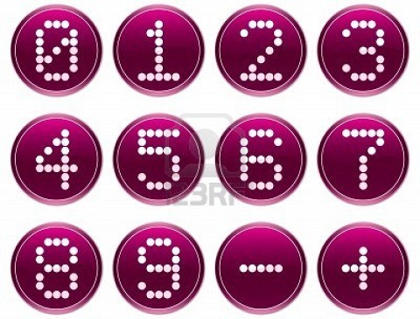
Algorithms (3)
Print all digits of a number
int number = 1234;
while (number > 0)
{
int remainder = number % 10;
number /= 10;
Console.WriteLine(remainder);
}

Slide 29

Algorithms (4)
N ^ M
Fibonacci – first 20 elements
int number = 10; int power = 3; int result = 1;
for (int i = 0; i < power; i++)
{
result *= number;
}
int first = 0; int second = 1;
For (int i = 0; i < 20; i++;)
{
int sum = first + second;
first = second; second = sum;
Console.WriteLine(sum);
}

Slide 30
Algorithms (5)
Calculating N factorial with BigInteger
Don't forget to add reference to System.Numerics.dll.
using System.Numerics;
static void Main()
{
int n = 1000;
BigInteger factorial = 1;
do
{
factorial *= n;
n--;
}
while (n > 0);
Console.WriteLine("n! = " + factorial);
}

Slide 31
Algorithms (6)
Find all prime factors of a number
int number, factor;
number = int.Parse(Console.ReadLine());
for (factor = 2; number > 1; factor ++)
if (number % b == 0)
{
int counter = 0;
while (number % factor == 0)
{
number /= factor;
counter++;
}
Console.WriteLine("{0} -> {1}",
factor, counter);
}

Slide 32
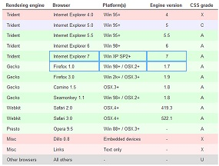
Arrays
Like tables

Slide 33
Arrays (1)
Arrays
Table like data type holding elements
Elements are get or set by index
For each index there is one value
Declare integer array with N elements
Get first and second value
int[] array = new int[N];
int number = array[0];
int secondNumber = array[1];

Slide 34
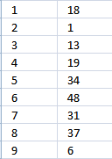
Arrays (2)
Set first or second value
Using for loop to iterate the array
array[0] = 10;
array[1] = 15;
int[] array = new int[10];
For(int i = 0; i < array.Length; i++)
{
array[i] = int.Parse(Console.ReadLine());
Console.WriteLine(array[i]);
}

Slide 35
http://algoacademy.telerik.com

Slide 36



Free Trainings @ Telerik Academy
“C# Programming @ Telerik Academy
csharpfundamentals.telerik.com
Telerik Software Academy
academy.telerik.com
Telerik Academy @ Facebook
facebook.com/TelerikAcademy
Telerik Software Academy Forums
forums.academy.telerik.com

